Slide 1

Benha University
Faculty of Science
Department of Zoology
Trematoda
إعداد : د. دعاء صبرى إبراهيم
مدرس بقسم علم الحيوان

Slide 2
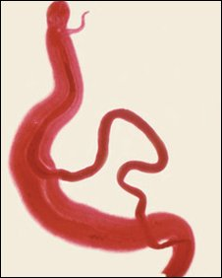
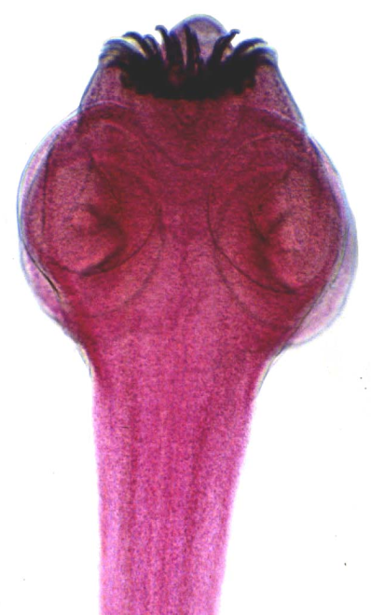
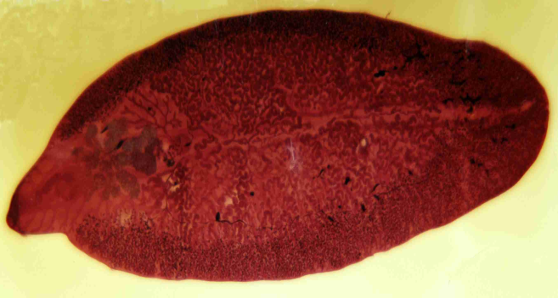
Phylum: Platyhelminthes
The Platyhelminthes or flat-worms are the lowest triploblastic animals and the first to develop distinct organs and systems.

Slide 3
General Characters of Platyhelminthes
Habitat: Most Platyhelminthes are parasites on other animals , only the Turbellarians are mostly free-living.
Body shape: Mostly worm like, generally dorsoventrally flattened and bilaterally symmetrical.
Structure: Body is triploblastic (having 3 layers of tissues) with organs and organelles and acoelomate (The space between the body wall and gut are filled with parenchyma composed of loose cell masses.).
Digestive system: When present, it consists of a blind gut (i.e. it has a mouth but no anus), therefore the digestive waste products were excreted through the mouths.

Slide 4
General Characters of Platyhelminthes (Cont.)
Respiratory and circulatory systems: They are absent. Respiration takes place by diffusion of the respiratory gases through the body surface into the surrounding medium.
Excretory system: Excretion is performed by specialized cells called flame cells. They lead into tubules which open out by one or more excretory pores.
Nervous system: Consisting of a pair of anterior ganglia with longitudinal nerve cords connected by transverse nerves.
Reproductive system: Both hermaphrodite and unisexual forms exist.
Classification: Platyhelminthes are classified into 3 classes; Turbellaria, Trematoda, and Cestoda.

Slide 5
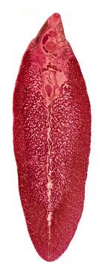
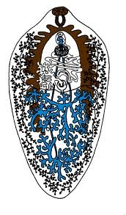
Kingdom: Animalia
Subkingdom: Metazoa
Phylum: Platyhelminthes
Class: Trematoda
Order: Digenea
Fasciola gigantica

Slide 6
Habitat
They live in the bile ducts of cattle and other mammals (primary or final host), feeding on the bile and causing the disease known as “liver rot” or fasciolosis as a result of the irritation caused by their surface spines; such irritation is sometimes fatal. The common species in Egypt and Africa in general is Fasciola gigantica, which infects cattle, sheep and goats. Another species is F. hepatica, which is more common in Europe and Australia. Species of freshwater snails are the intermediate hosts (e.g. Galba truncatula for F. hepatica and Limnaea cailliaudi for F. gigantica).

Slide 7
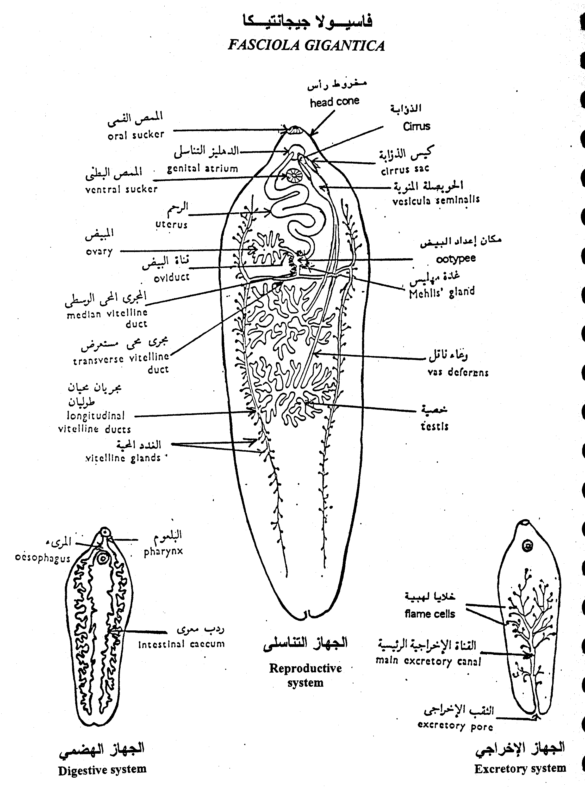
Morphology

Slide 8
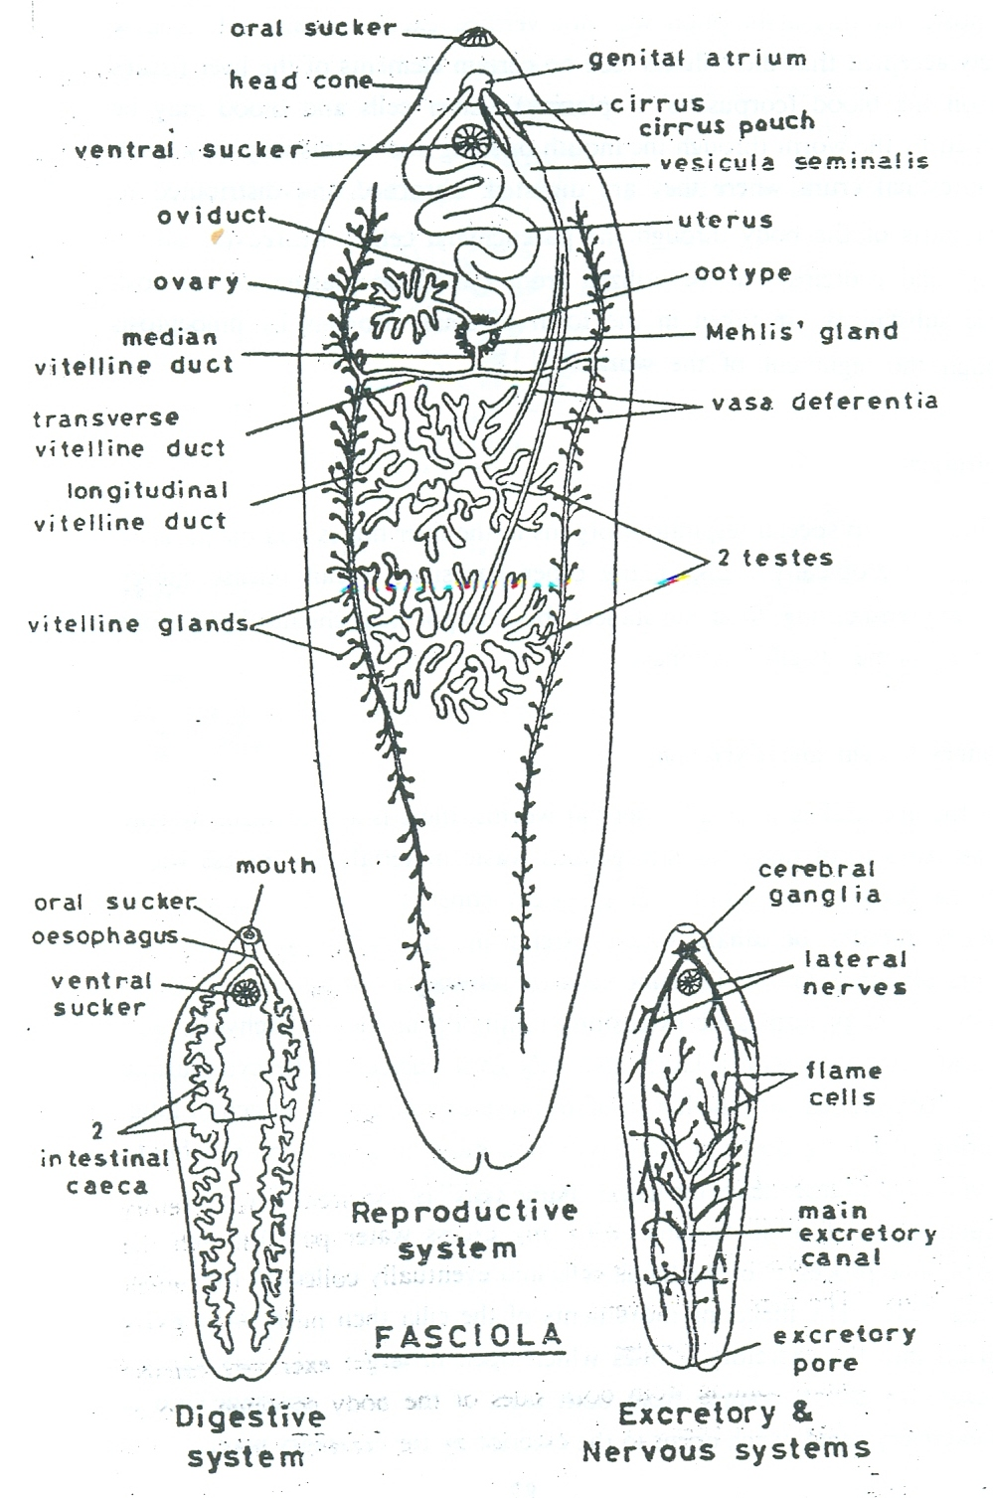
Digestive system and nutrition

Slide 9
Excretory and nervous systems

Slide 10
Reproductive systemn

Slide 11
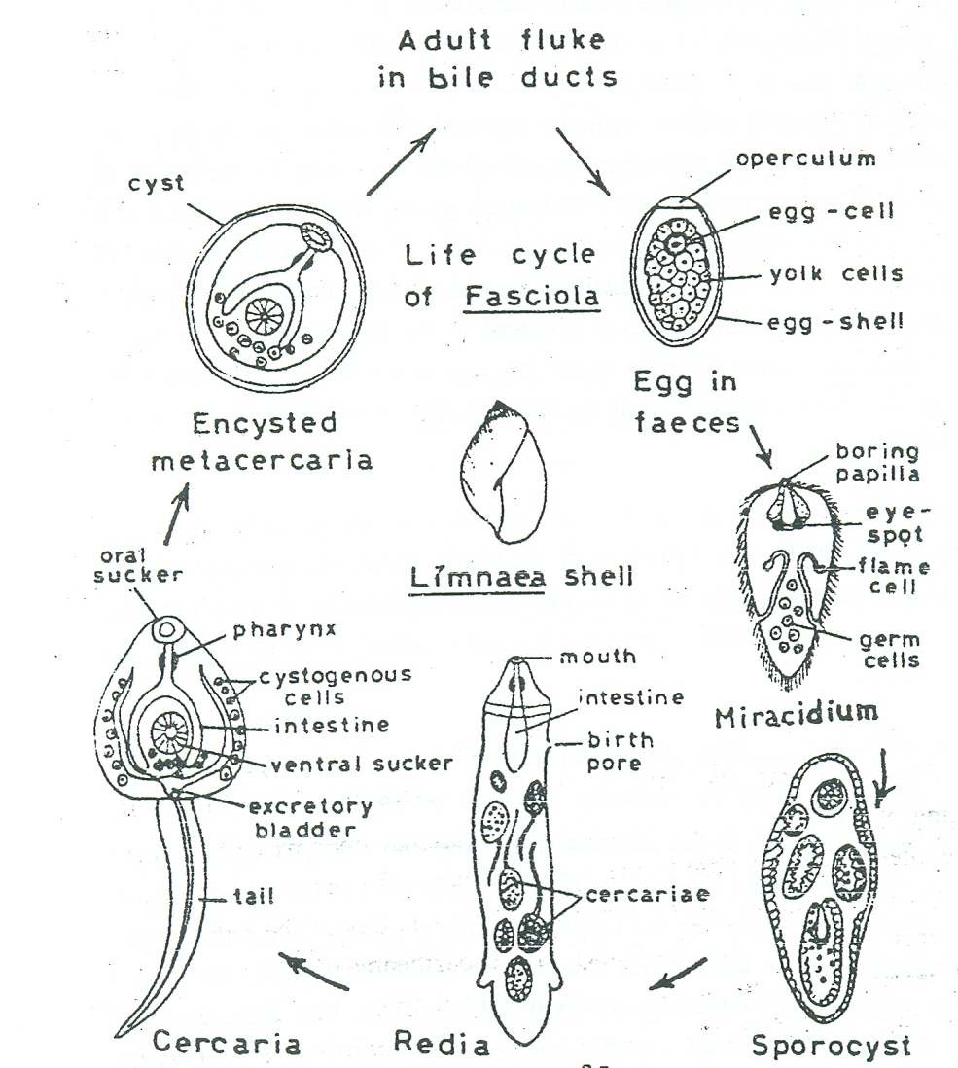
Life cycle

Slide 12
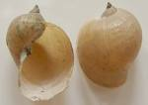

Limnaea shell
Cercaria of Fasciola

Slide 13
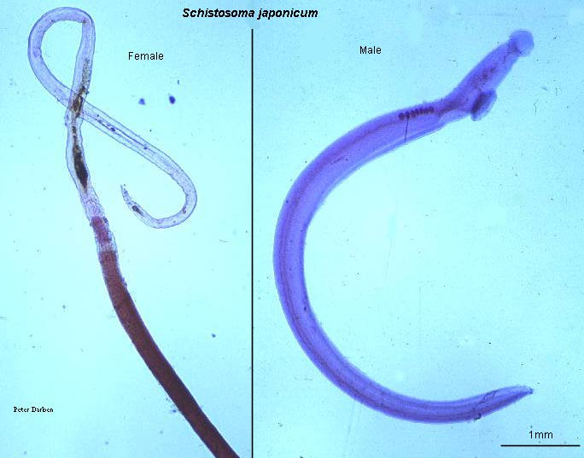
Kingdom: Animalia
Subkingdom: Metazoa
Phylum: Platyhelminthes
Class: Trematoda
Order: Digenea e.g.: Schistosoma

Slide 14
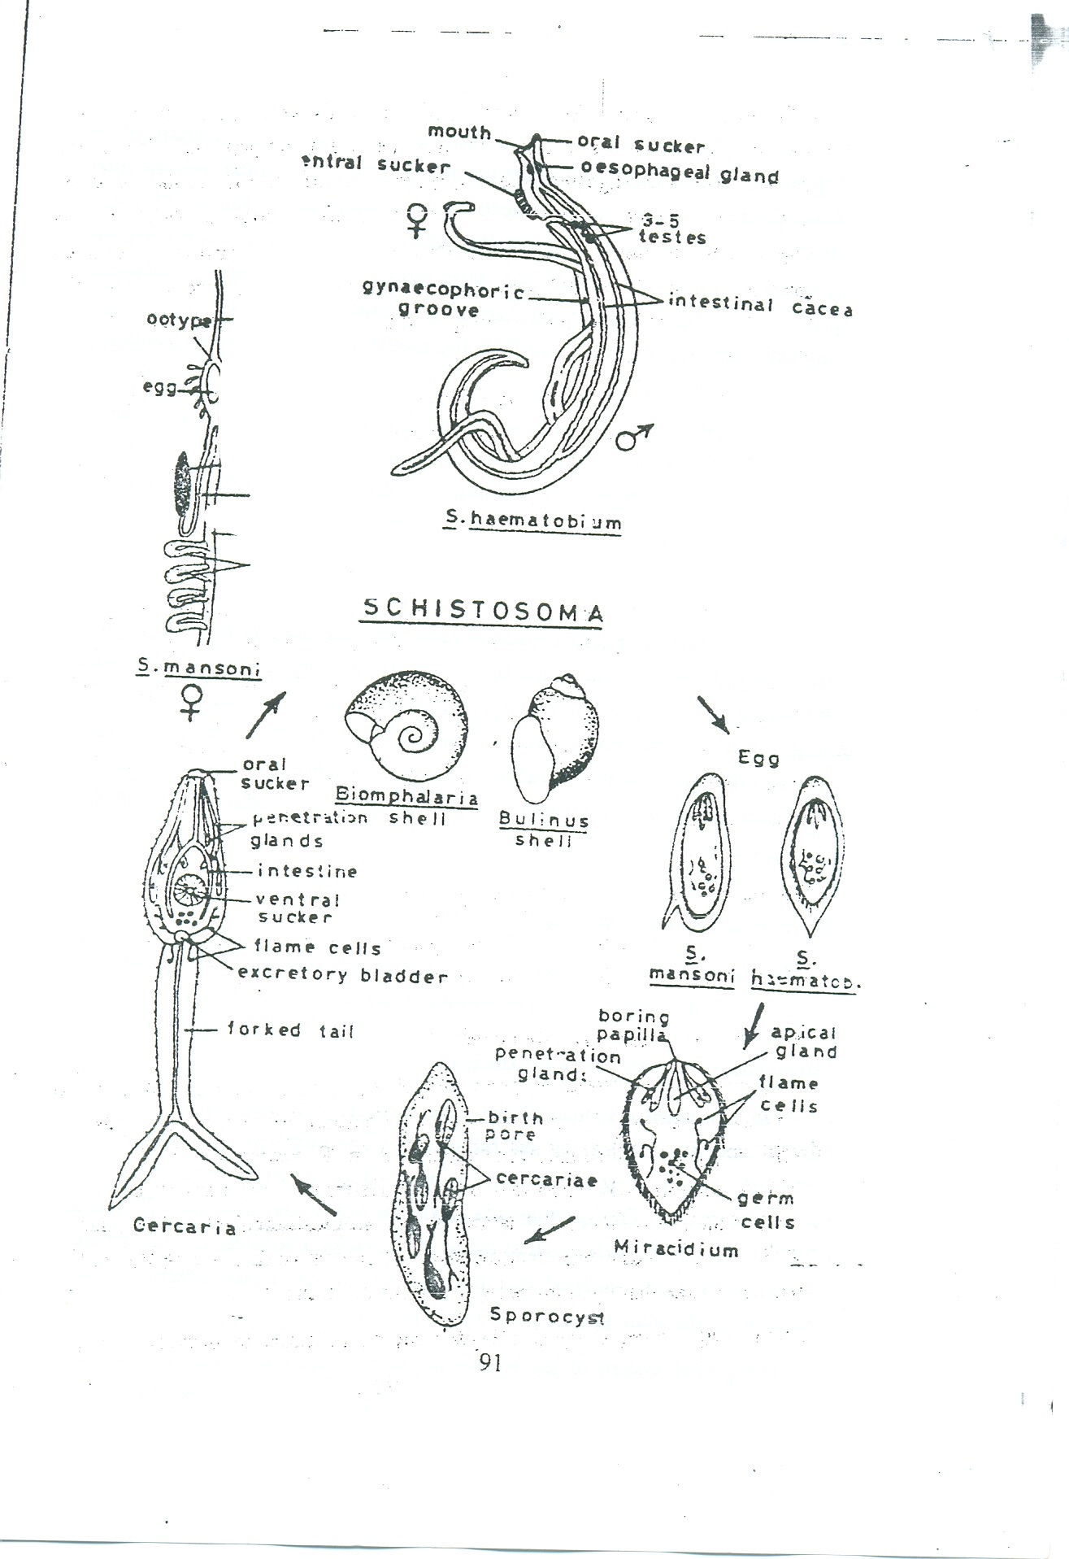
Digestive system and nutrition
The alimentary canal starts with a small buccal cavity which leads into a thin oesophagus surrounded by an oesophageal gland. The oesophagus leads to the intestine which divides in front of the ventral sucker into two intestinal caeca, but these reunite to form a single sinuous common caecum.

Slide 15
Respiration, Excretory, Nervous and Muscular Systems
Excretory, nervous and muscular systems:
These systems are similar to those of Fasciola.
Respiration:
Like the liver flukes, schistosomes have no specialized system for respiration. Although they live in the blood where the oxygen tension is relatively high, respiration appears to be largely anaerobic

Slide 16
Reproductive system

Slide 17
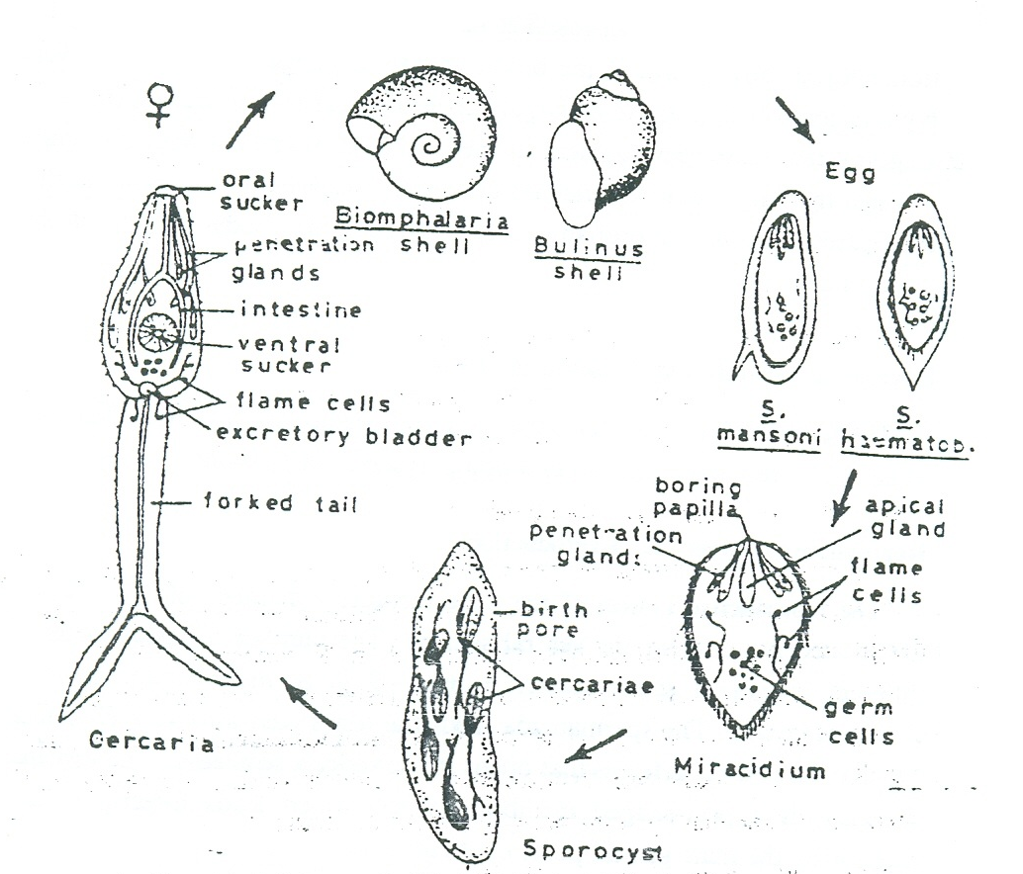
Life cycle

Slide 18
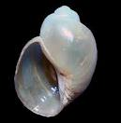

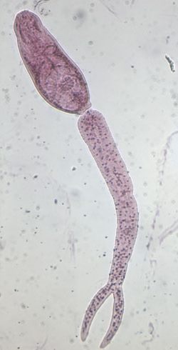
Bulinus shell
Biomphalaria shell
Schistosoma cercarea

Slide 19


